Slide 1

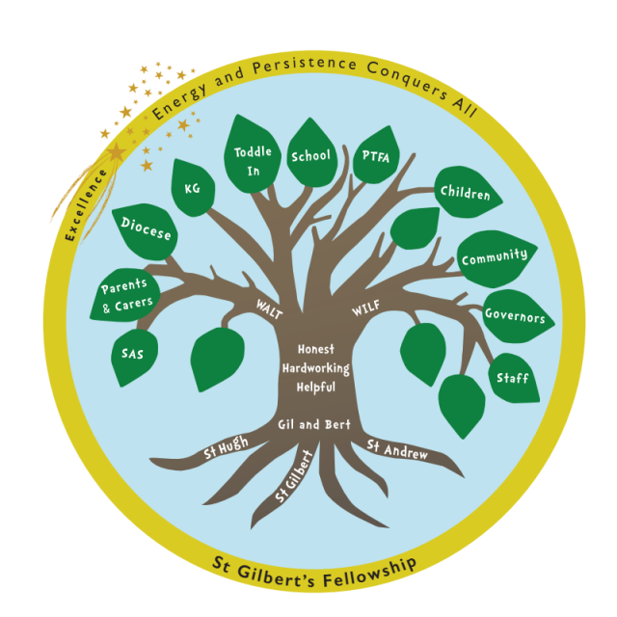
Welcome to St. Gilbert of Sempringham Church of England Primary School and Nursery
Foundation Stage Information Evening
2025
Notes:
Firstly I’d like to welcome you and your child to st gilbert of Sempringham c of e primary school. My name is Ms Markley and I am the hedgehogs class teacher at st gilbert’s school and Miss Craigie is the class TA.

Slide 2
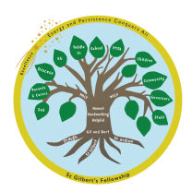
Our School
Executive Head Teacher Mrs Foston
Assistant Head Mrs Tubb
Administrator Mrs Susan McArd
Nursery: 2- to 4-year-olds Ms Markley (EYFS LEAD)
Clare, Jade, Kayleigh
Hedgehogs Ms Markley
Red Squirrels Mrs Tubb
Badgers Mr Adams
HLTA Mrs Watkins
Teaching Assistants: Miss Craigie
Mrs Oxley
Lunchtime Supervisors: Miss Rollings

Slide 3


Welcome to our School
This is the beginning of your child’s School journey
We want to be able to answer all your questions
Provide a brief introduction to our school and in particular Hedgehogs class.
Notes:
In Today’s meeting we are going to look at the following information. The following presentation aims to:
provide a brief introduction to the Foundation Stage (EYFS) and its curriculum.
To find out how a typical school day is organised and what your child will need to bring to school in September.
Understand school procedures for illness and other important matters.
Ask any questions.

Slide 4
Celebrating Success
Celebrating Success Awards in our weekly Celebration Assembly, including, reader of the week, star of the week and citizen of the week,
Following our Ofsted inspection in 2024 we have a “Good” grading. “St Gilbert of Sempringham Church of England Primary School is caring and inclusive. The school has high expectations of what pupils can achieve.”
We are currently at the top of the league for the Interschool Archery
We have taken part in the Brownlee Foundation Triathlon Events
We have an active Parents’ Association.
After School and Lunchtime clubs.

Slide 5
What to expect when your child starts school
We offer a thorough transition process that involves:
● Visits to nurseries and preschools to meet children and discuss their needs with their current key workers and where they are on their learning journey.
● New parents’ meeting to come and meet the staff and see the learning environment
● Stay and play ‘Getting to know you’ sessions at the end of this year as part of our phased start to school
We focus heavily on children’s personal, social and emotional needs as well as their language and communication at the start of school, to ensure a smooth transition into school life and the opportunity for children to get to know staff and other children within a welcoming and supportive environment, that provides lots of opportunity for exploring their own interests through play and meeting new friends.

Slide 6
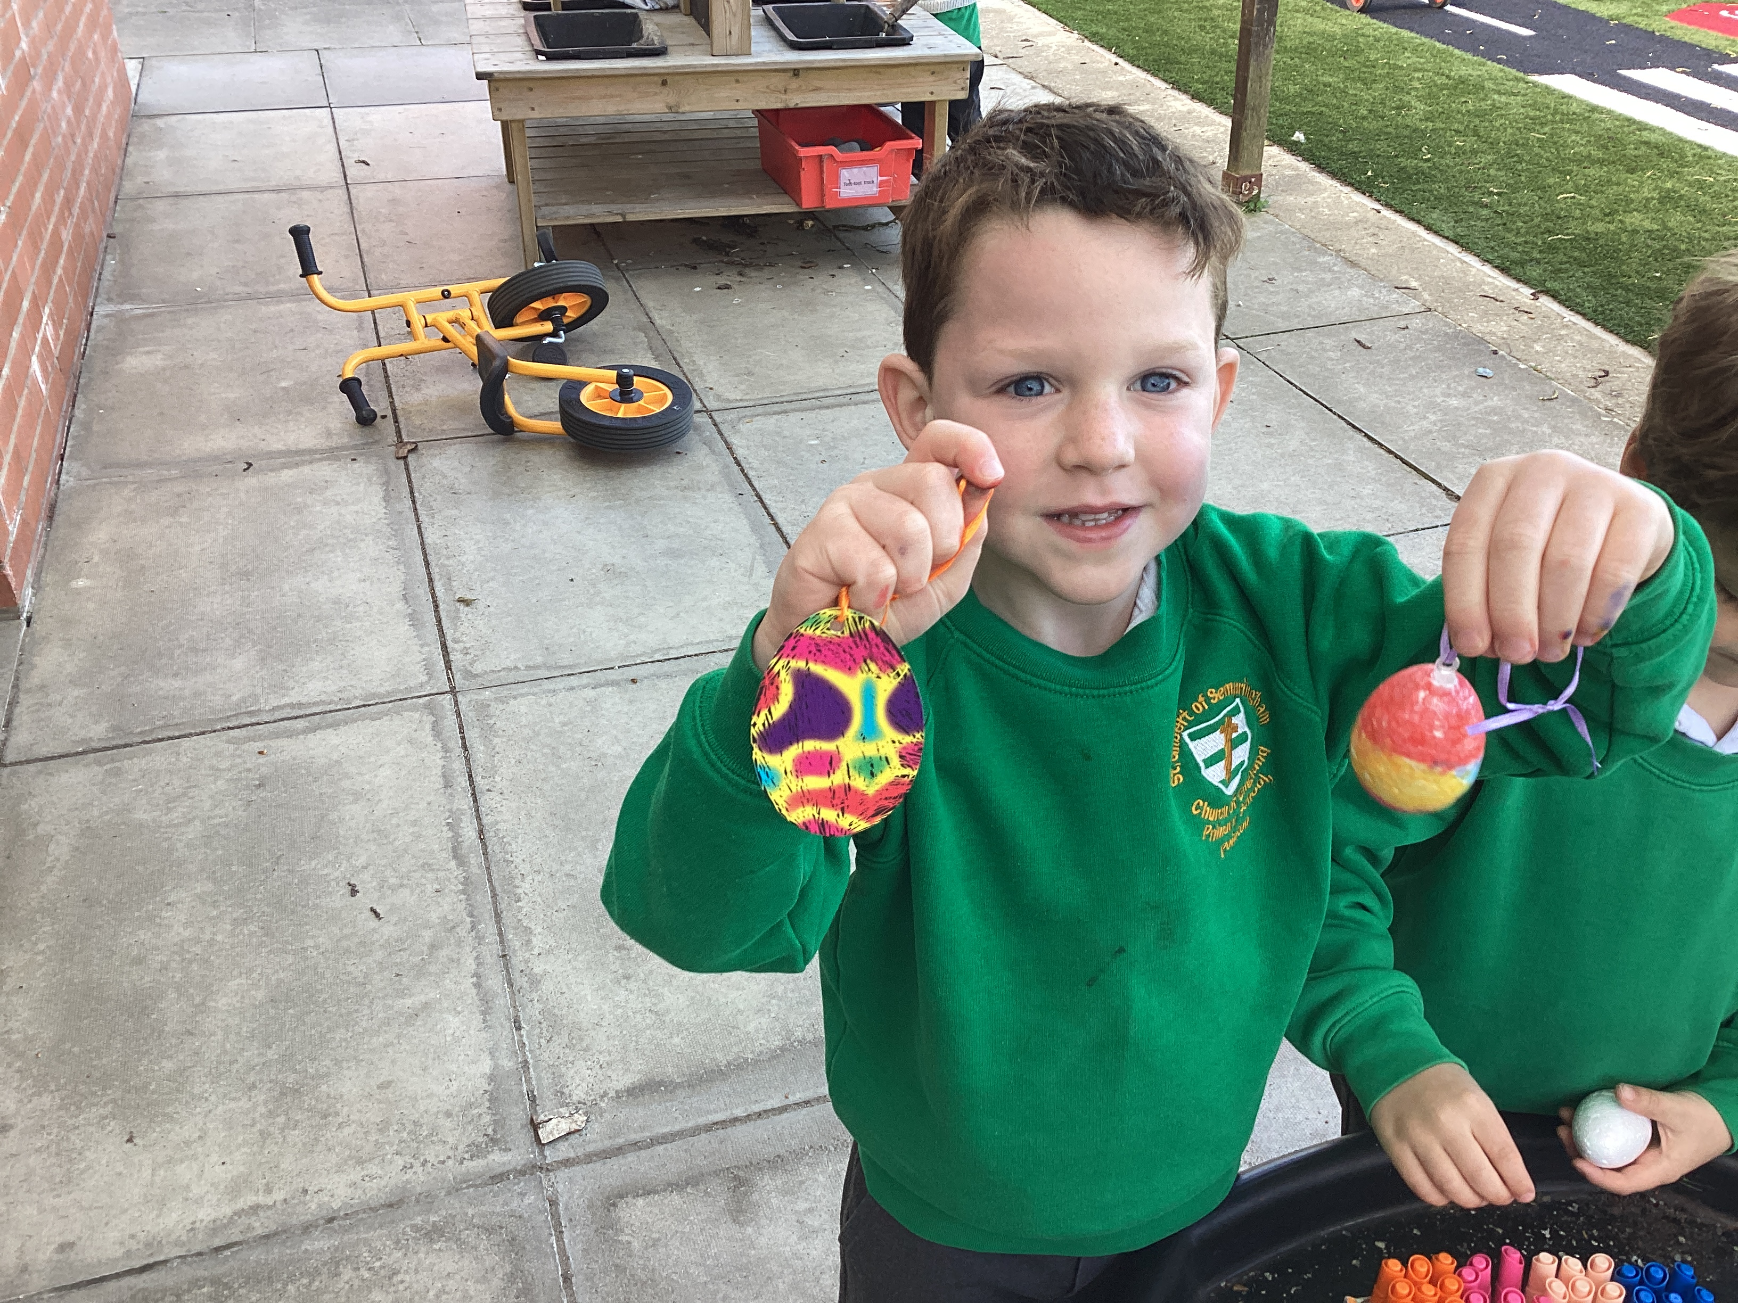
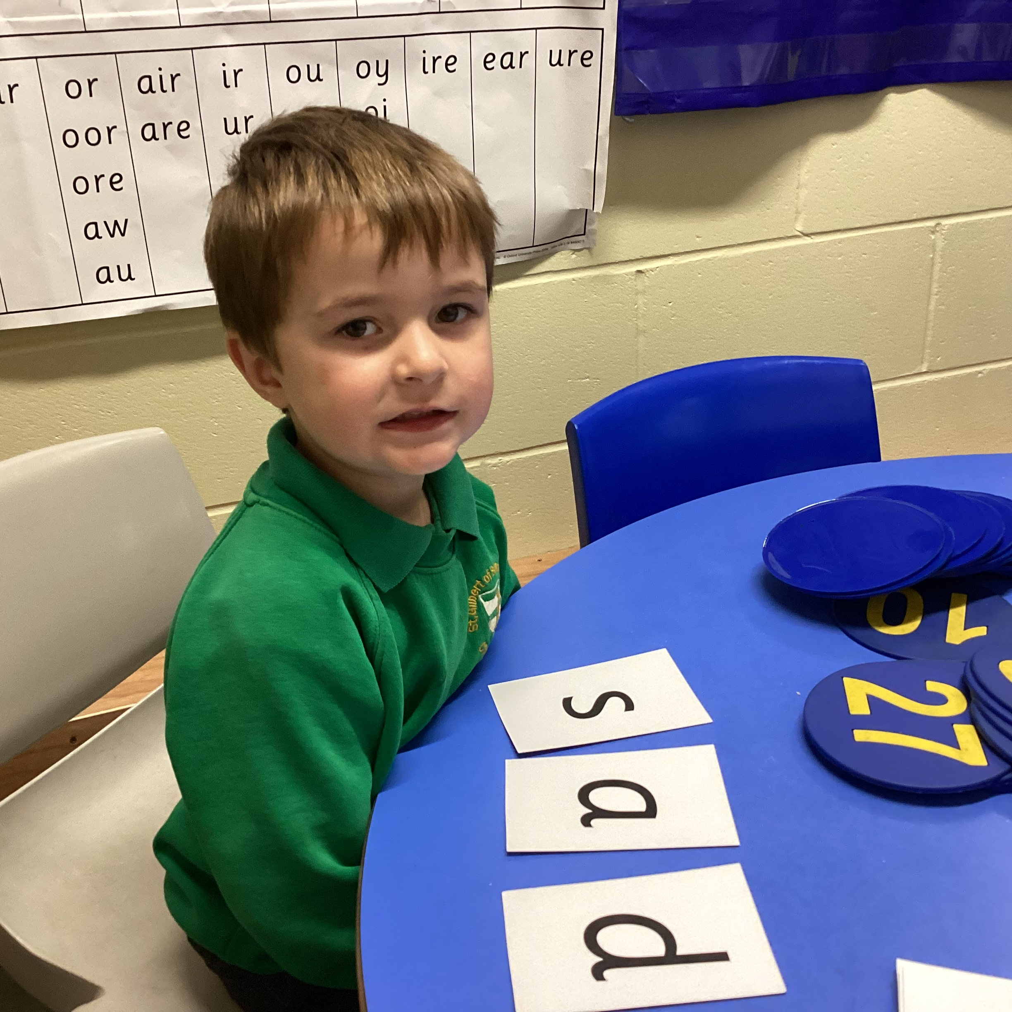
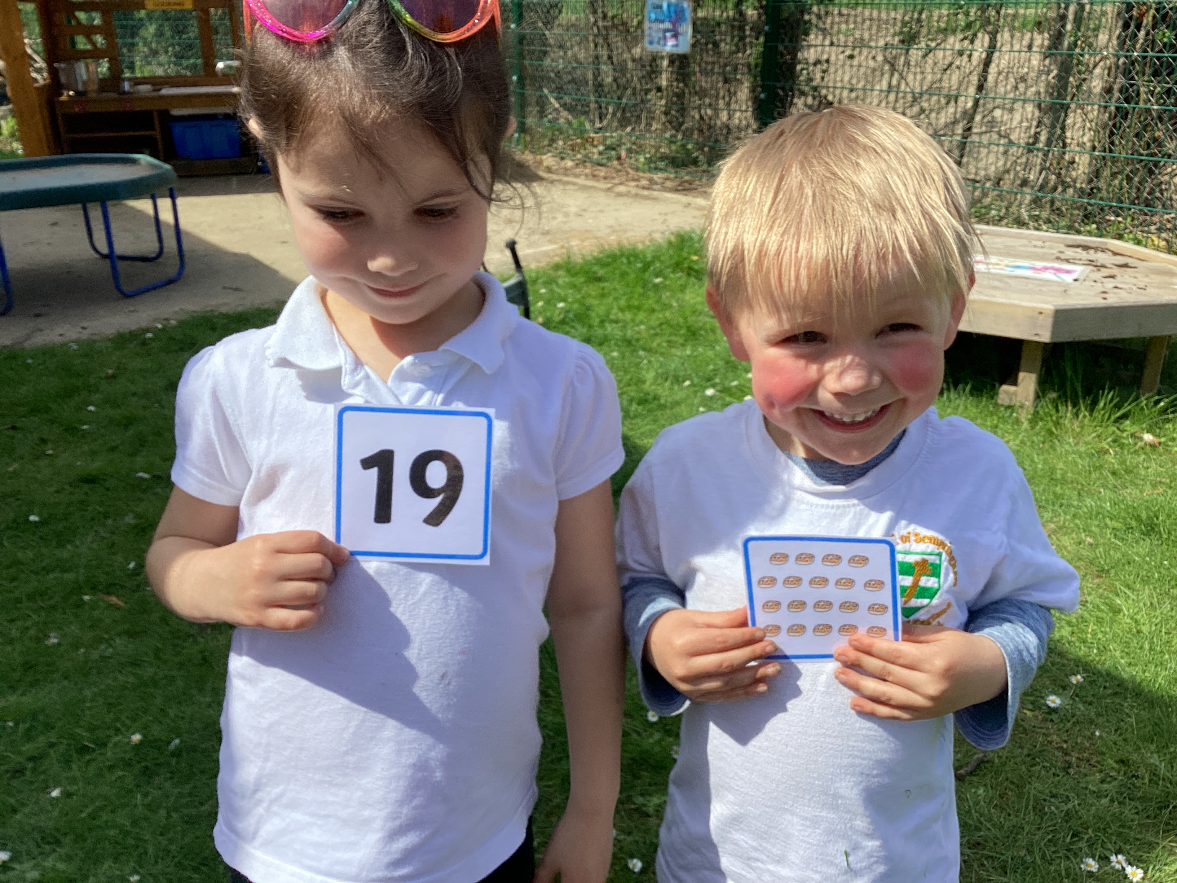
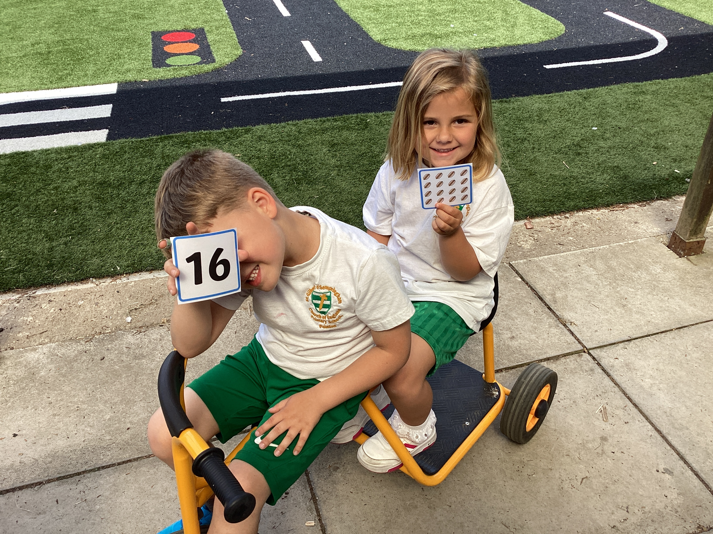
How we learn at St Gilbert’s

Slide 7
What is the Early Years
Foundation Stage (EYFS)?
The EYFS is the stage of learning for children from birth to the end of the Reception year.
It is based on the recognition that children learn best through play and active learning. In Hedgehogs learning for our EYFS children is promoted through lots of hands on, practical learning. There are also lots of collaborative learning opportunities with their classmates.
Children will learn through both child initiated and adult initiated/ directed tasks. This is reflected inside the classroom and outdoors.
Notes:
The EYFS is the stage of learning for children from birth to the end of the Reception year.
It is based on the recognition that children learn best through play and active learning which I will explore further later in the presentation. In Reception this will be based around our termly topics.
Children will learn through both child initiated and adult initiated/ directed tasks and reflected inside the classroom and outdoors.

Slide 8
Foundation Stage Curriculum
The Foundation Stage Curriculum has 7 areas of learning.
These are crucial for developing children's curiosity and enthusiasm for learning and provide the foundations from which all other learning can build upon.
Areas of Learning and Development
Prime Areas
Communication and language | Physical development | Personal, social and emotional development
Listening, attention and understanding Speaking | Gross motor skills Fine motor skills | Self-regulation Managing self Building relationships
Specific Areas
Maths | Literacy | Understanding the world | Expressive arts and design
Number Numerical patterns | Comprehension Word reading Writing | Past and Present People, culture and communities The natural world | Creating with materials Being imaginative and expressive
Notes:
The foundation stage is split into 7 areas of learning.
Prime areas – psed pd and communication and language.
The prime areas begin to develop quickly in
response to relationships and experiences, and
run through and support learning in all other areas.
The prime areas continue to be fundamental
throughout the EYFS. They are underpinned in everything we do at st gilberts. Especially during the start of reception there is a key focus on Personal, social and emotional development. We place particular emphasis on developing friendships, self-confidence and understanding school rules and expectations.
The specific areas include essential skills and
knowledge. They grow out of the prime areas,
and provide important contexts for learning. These include literacy maths uw ead.
The specific areas of learning are a major part of our daily timetable. Children are given learning opportunities through informal play and also through more sit down formal teaching. It is the combination of both learning styles that help to develop the children’s curiosity and enthusiasm for learning as they move through the school.

Slide 9
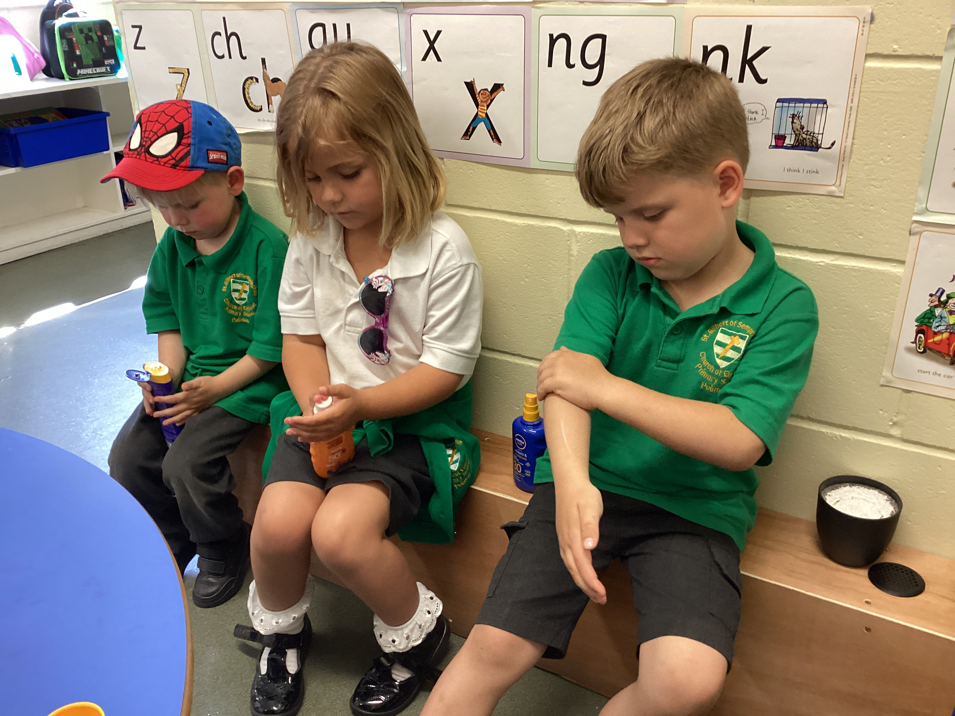
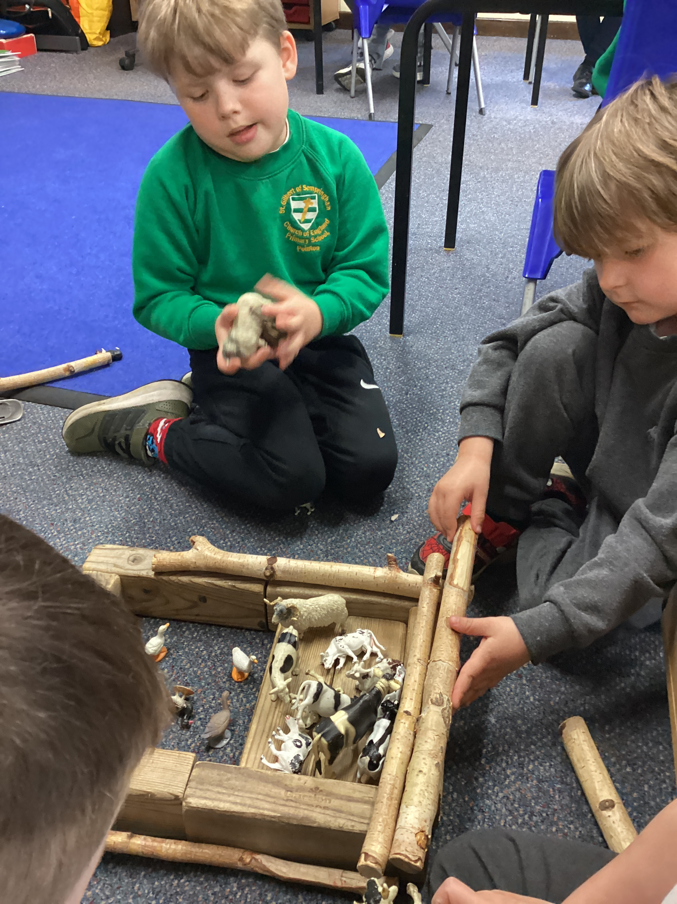
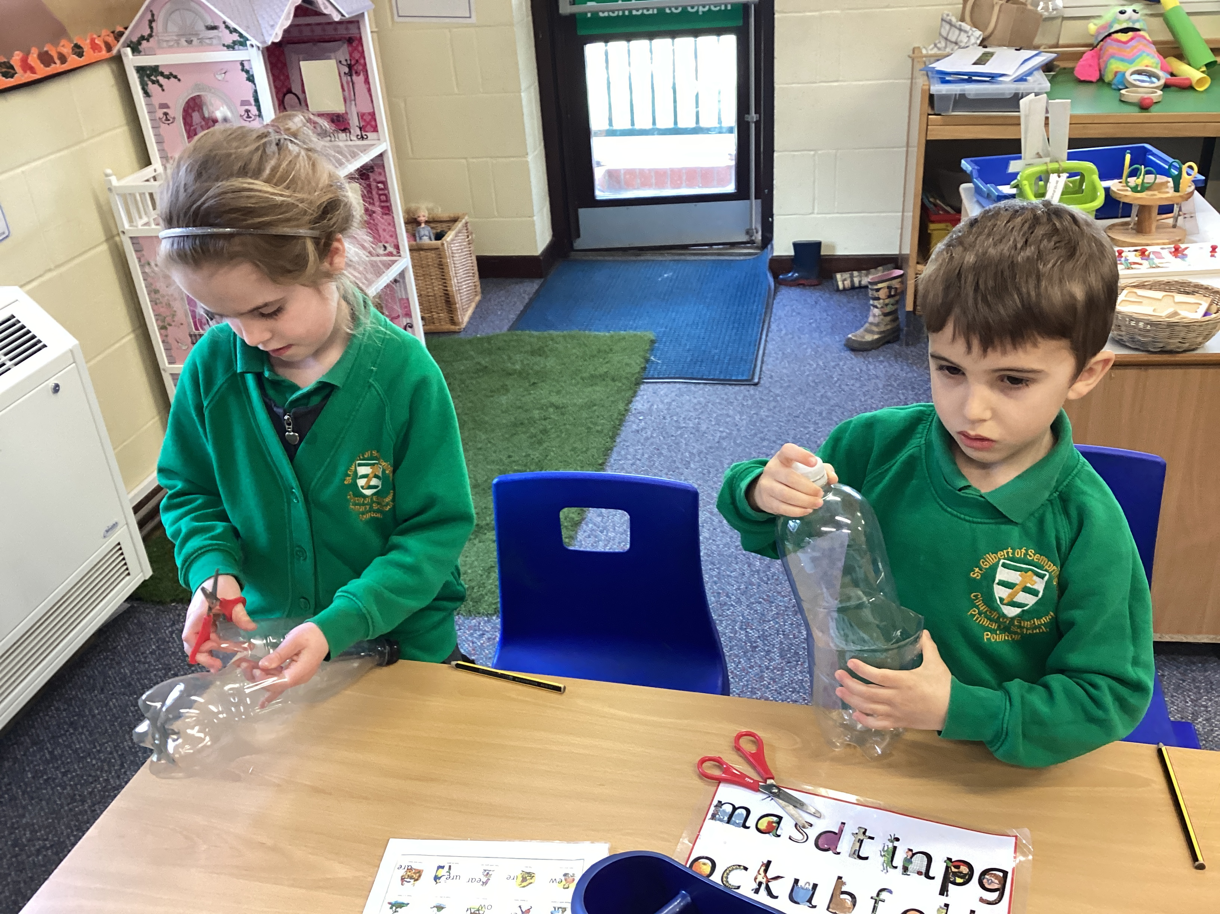
Personal, Social and Emotional Development
Self-regulation
Managing self
Building relationships
Notes:
Firstly looking at the prime areas of learning. PSED is made up of 3 key areas. It is a key part of learning for reception children. The children will begin to develop their abilities to form friendships with their peers. We don’t teach this as a stand alone lesson but instead embed opportunities for development in this area throughout the school day.

Slide 10
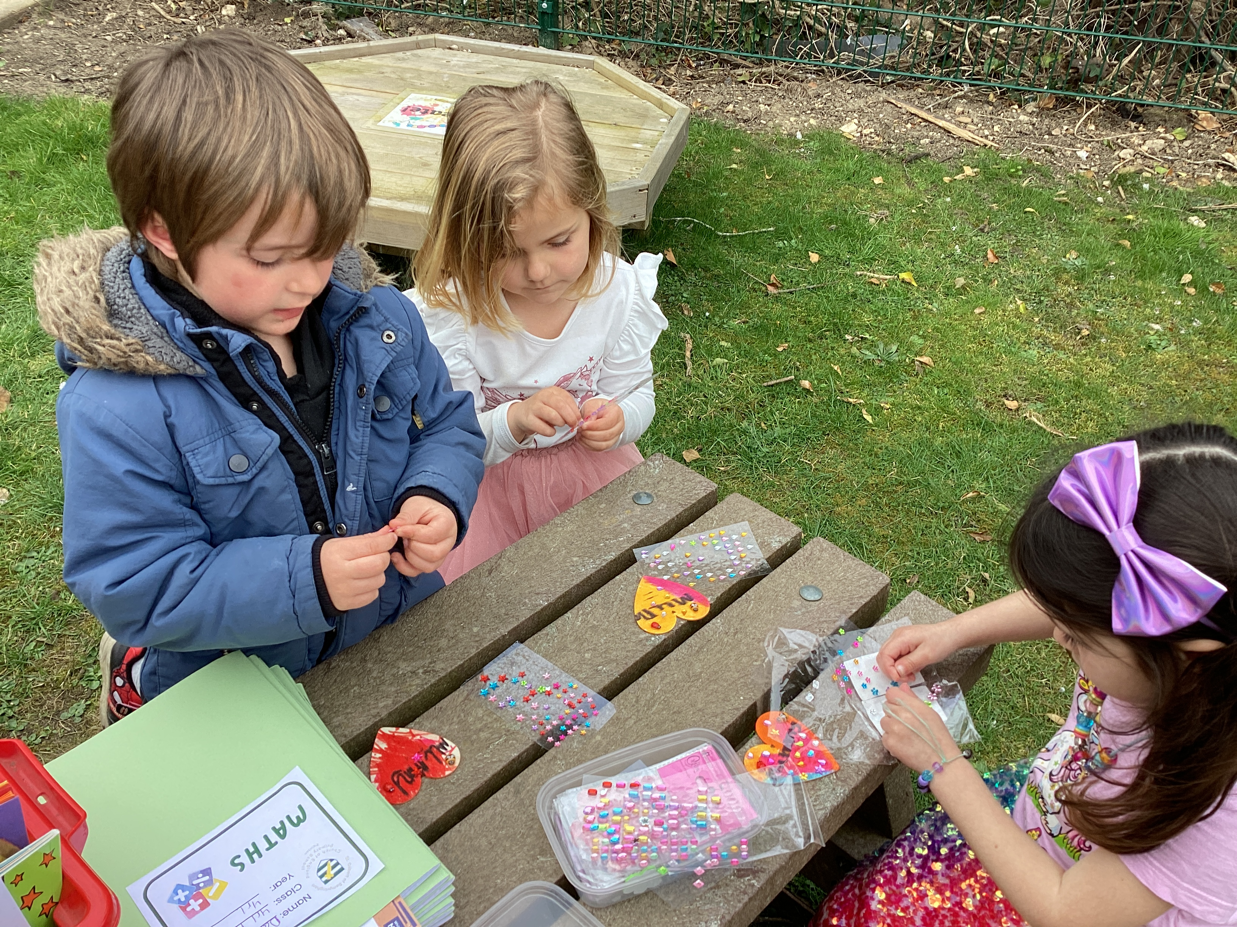
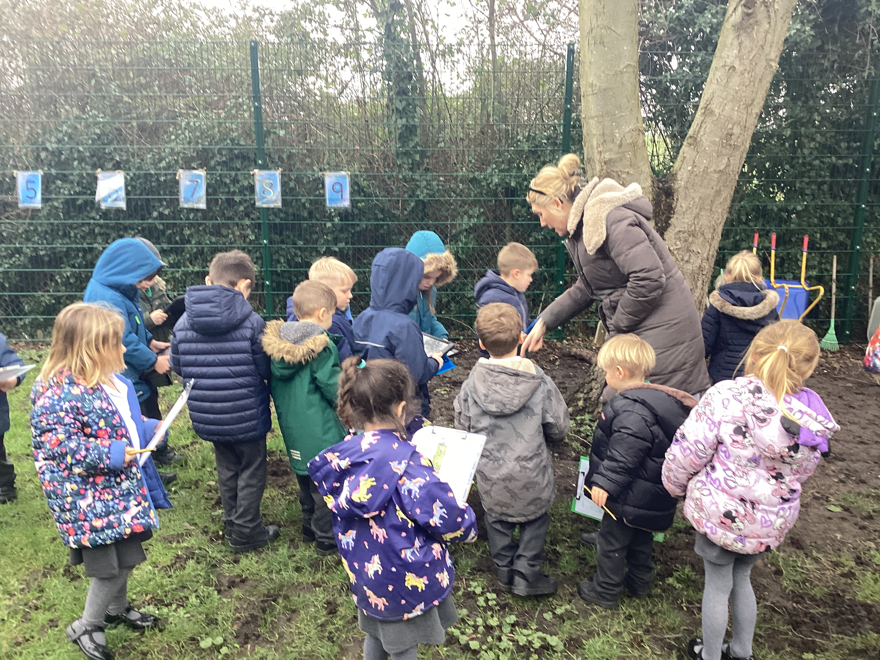
Communication and Language
Listening, attention and understanding
Speaking
Notes:
Similarly communication and language is embedded within our daily curriculum. We actively support and promote a language rich learning environment.

Slide 11
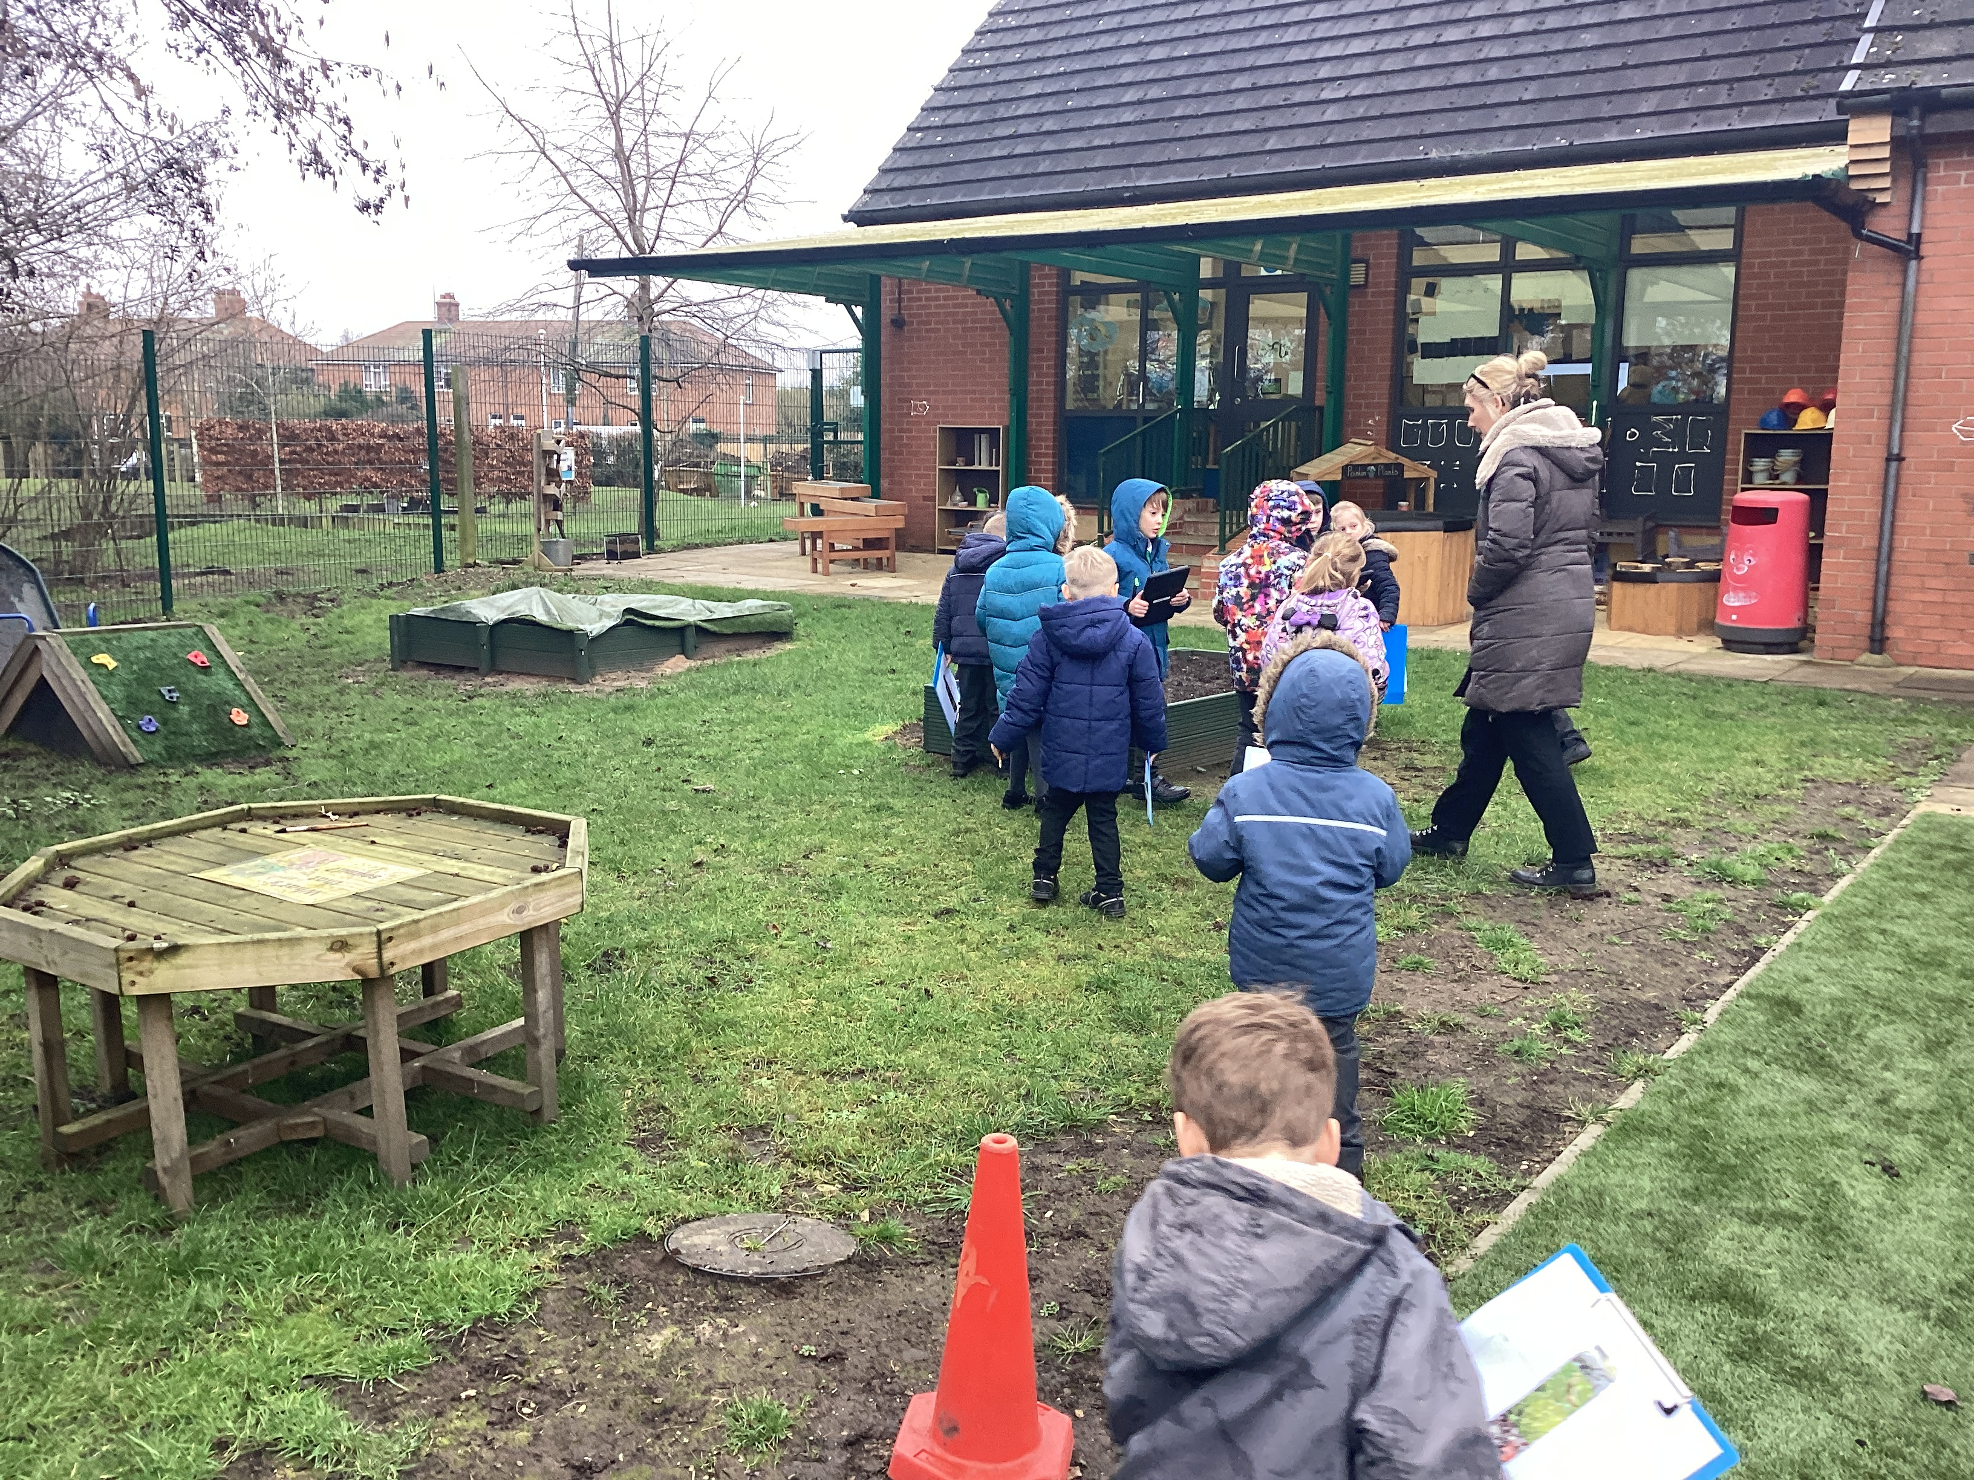
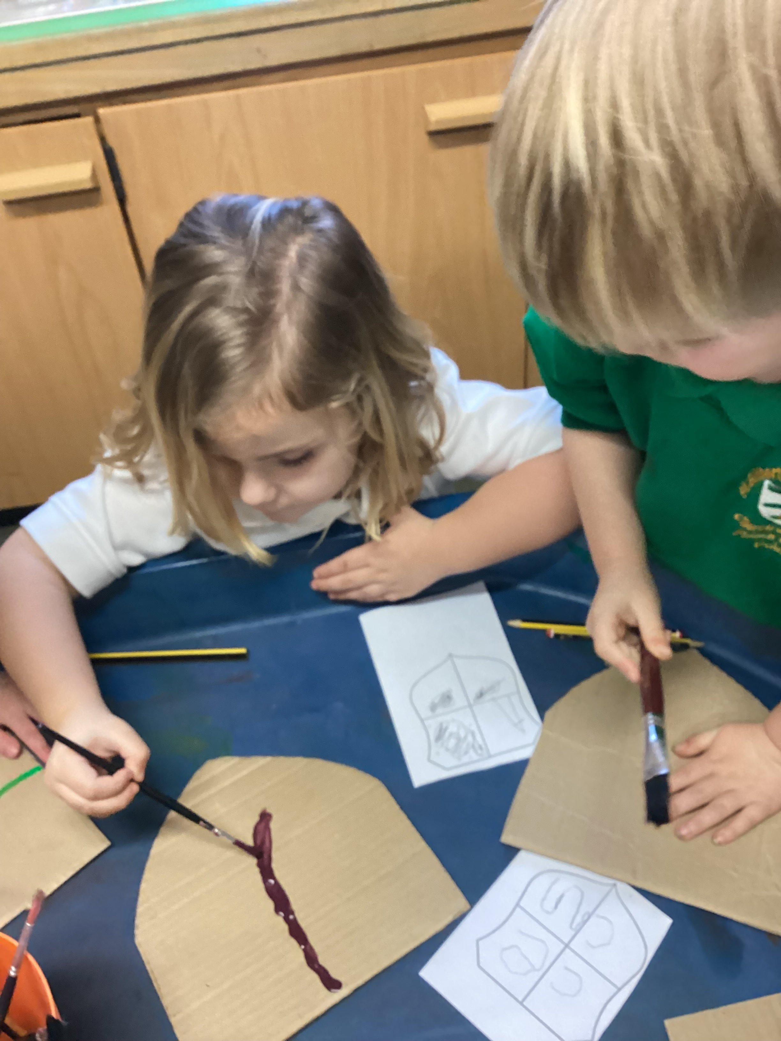
Physical Development
Gross motor skills
Fine motor skills
Notes:
During the school day, the children have lots of opportunities to develop physically. Our main focus in reception is to develop the children’s fine motor skills such as activities like playdough, using tweezers, threading etc. The children also have access to our outdoor area every single day where they can develop their gross motor skills. We have lots of bikes, scooters, space to run in, climbing equipment etc. We also have weekly PE lessons where the children will start to develop skills such as dance, athletics, ball skills etc.

Slide 12







4 Specific Areas
1. Literacy (L)
2. Mathematics (M)
3. Expressive Arts and Design (EAD)
4. Understanding the World (UW)
The specific areas include essential skills and knowledge.
They grow out of the prime areas, and provide important
contexts for learning.
The prime and specific Areas of Learning and Development
are all interconnected.
Throughout the Reception Year, children will work towards achieving Early Learning Goals in all areas of learning.
Notes:
Now we will consider the four specific areas of learning: They are broken up into
1. Literacy (L)
2. Mathematics (M)
3. Expressive Arts and Design (EAD)
4. Understanding the World (UW)
The specific areas include essential skills and knowledge.
They grow out of the prime areas, and provide important
contexts for learning.
The prime and specific Areas of Learning and Development
are all interconnected.
Throughout the Reception Year, children will work towards achieving Early Learning Goals in all areas of learning.

Slide 13

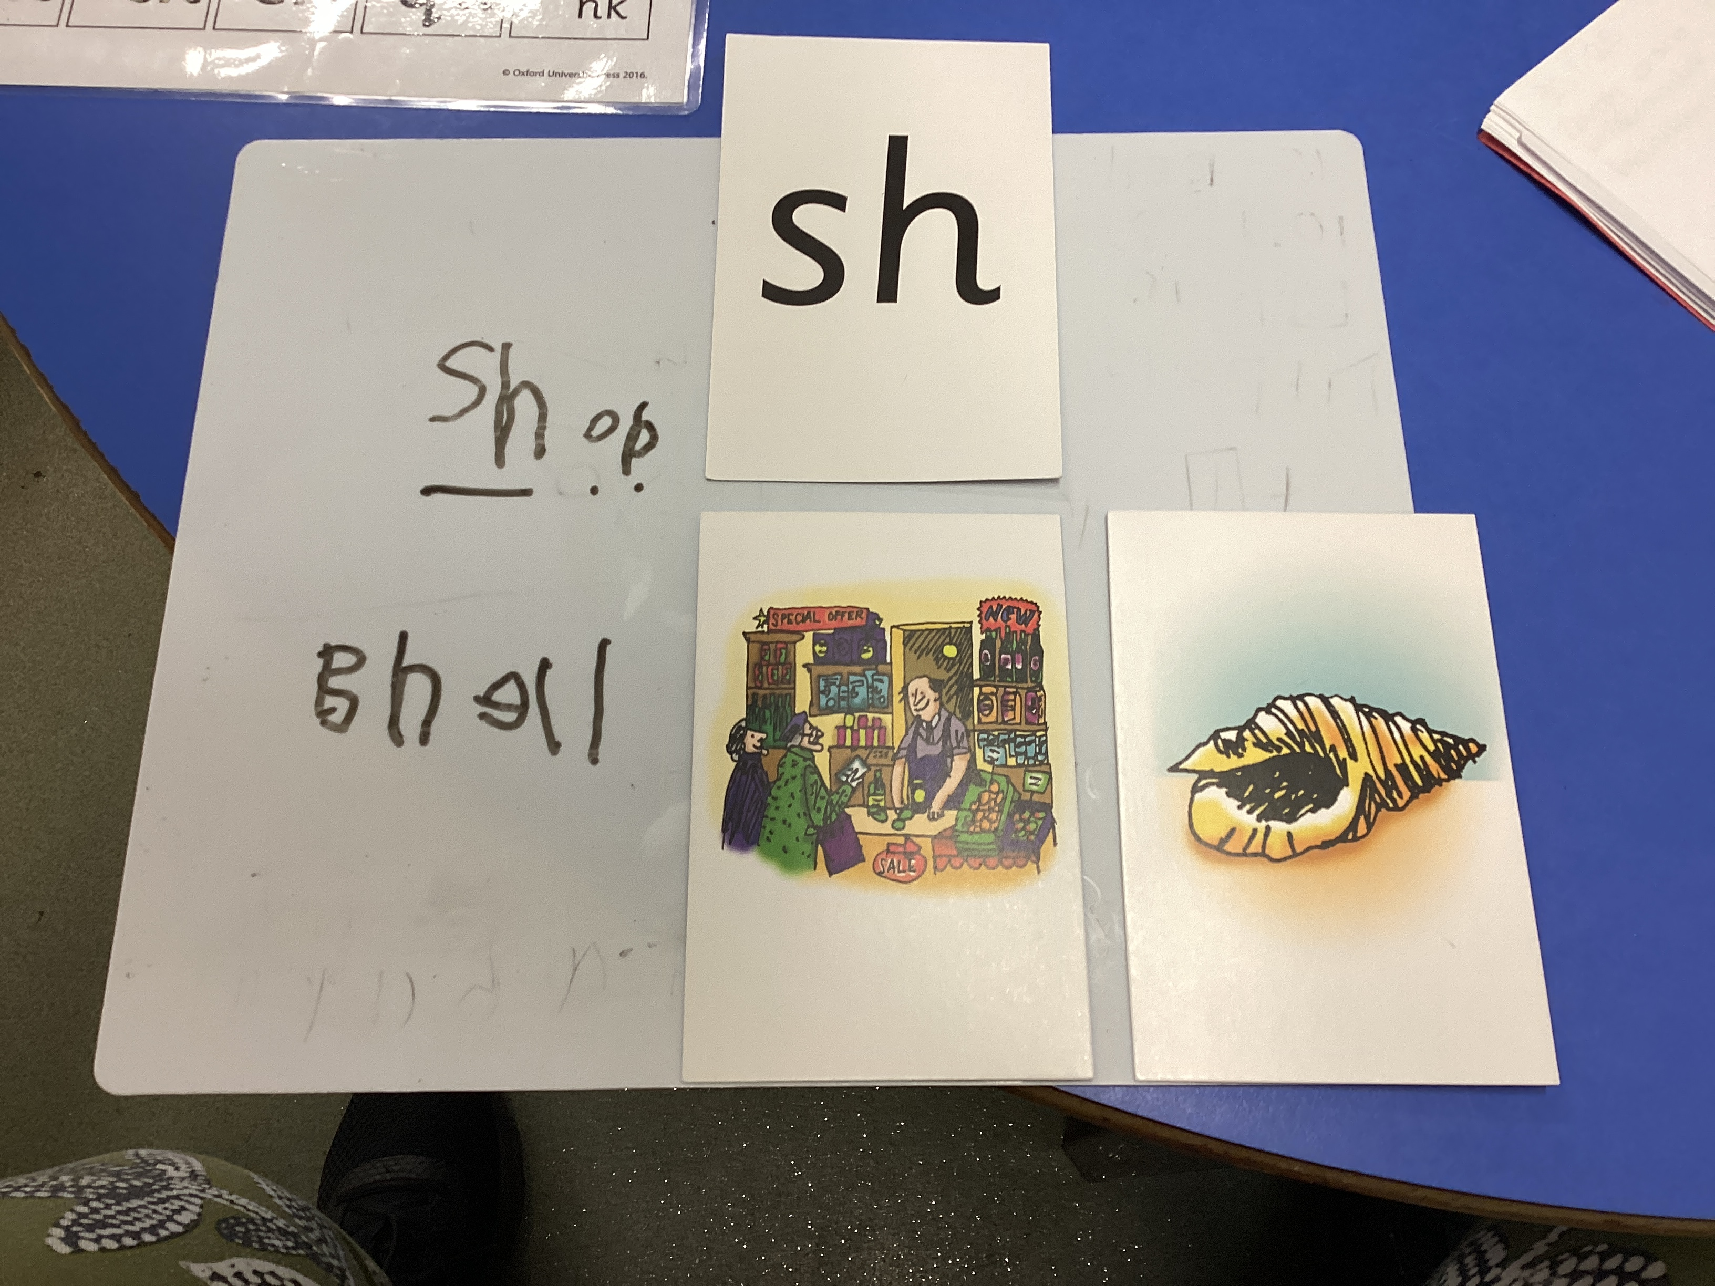
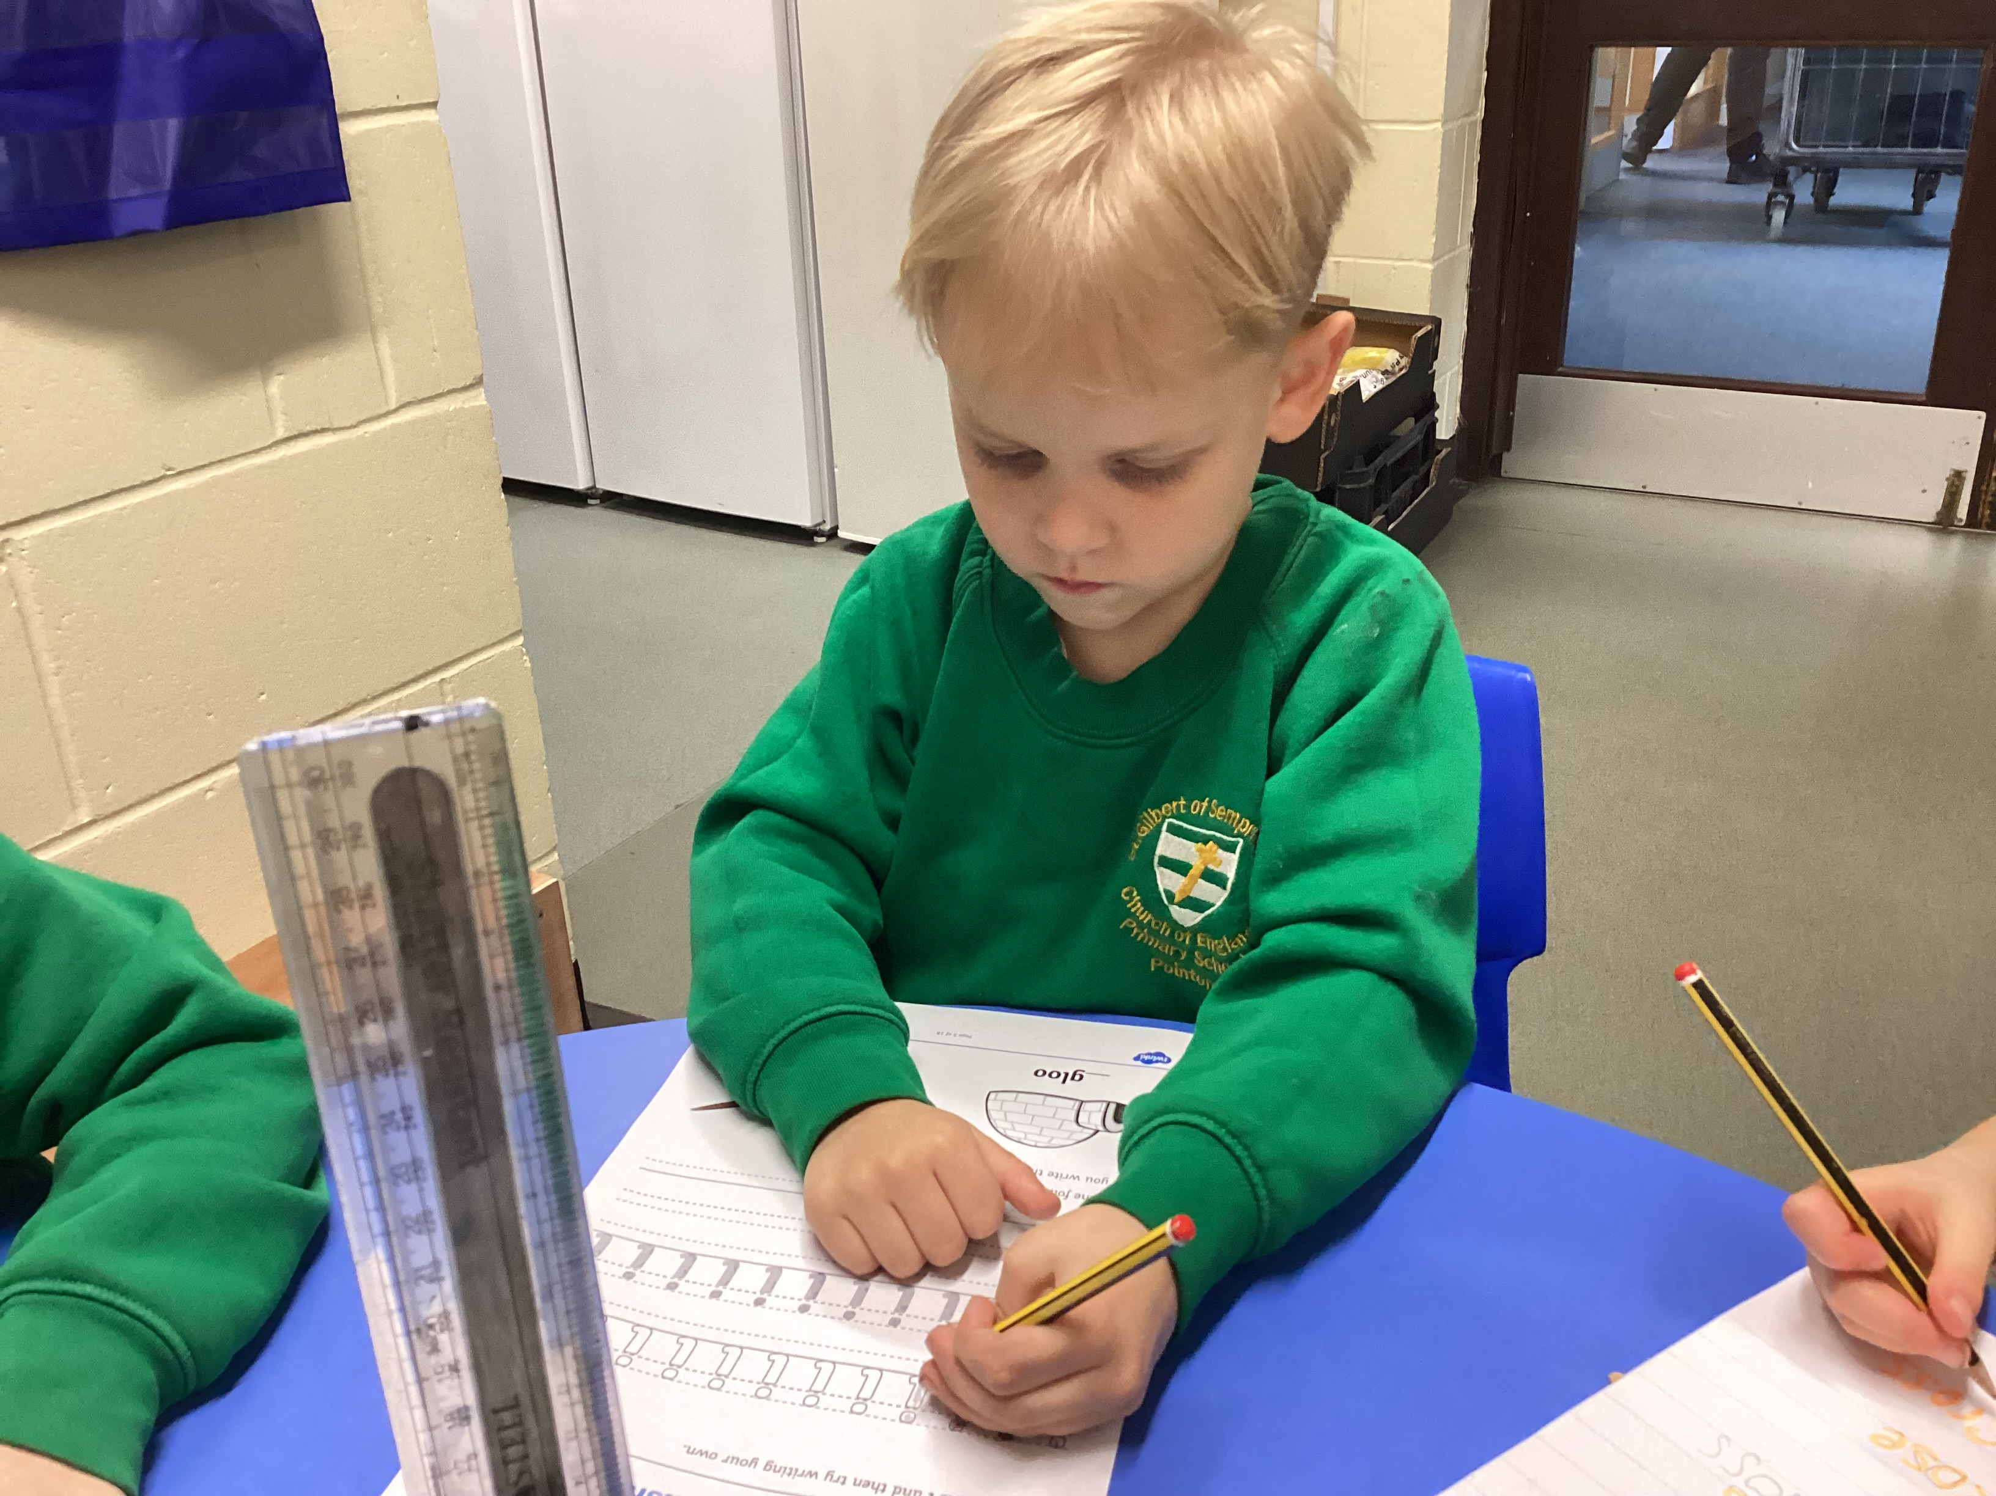
Literacy
Comprehension
Word reading
Writing
Notes:
Our main focus for literacy is phonics. Phonics is the ability to decode letters on a page into words. Until the ability to do this is secure, reading will be hard work and quality comprehension will not take place!
Decoding is a relatively low level skill, but for many a skill that needs to be taught regularly and intensively until it is mastered therefore phonics is taught daily. At st gilbert’s we follow a scheme called RWI. Read write inc sessions are taught by all staff accross the school, children are assessed termly and grouped accordingly. The sessions are fun and interactive and include learning different sounds, reading and writing. The children are then assessed again at the end of each term and grouped accordingly. The children will also be sent home with reading books, green words and red words. These words directly correspond to the set of sounds they are currently learning.
The children also have lots of other literacy opportunities within the day. They have access to a reading corner, a writing area inside and outside and they are encouraged to interact with these regularly. We are also currently undertaking our brinze award for the promotion of reading for pleasure- this is something that we are very passionate about.

Slide 14
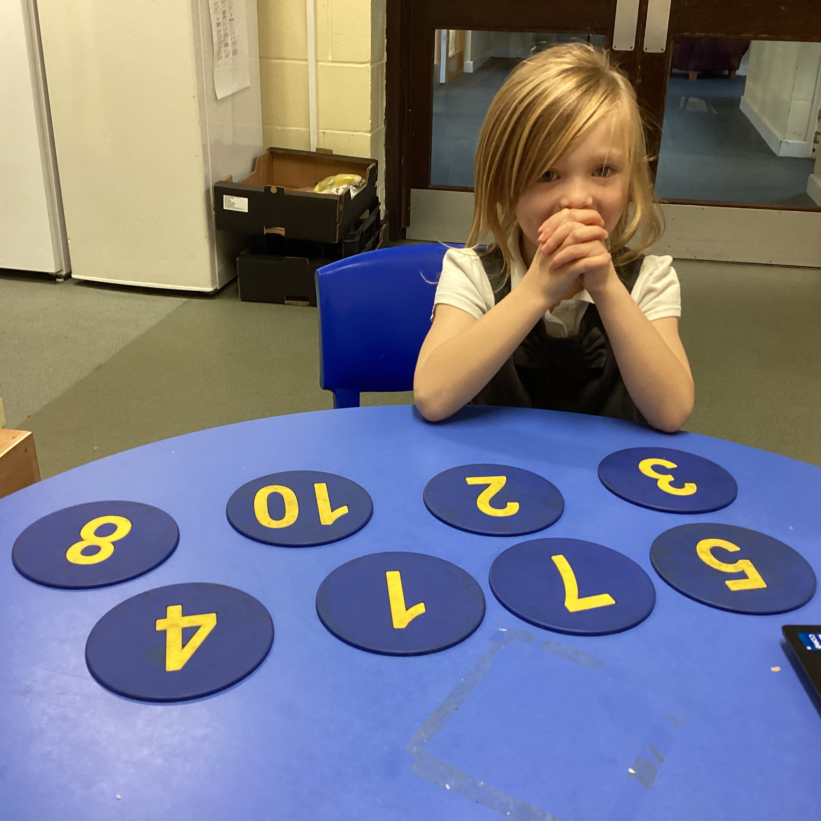
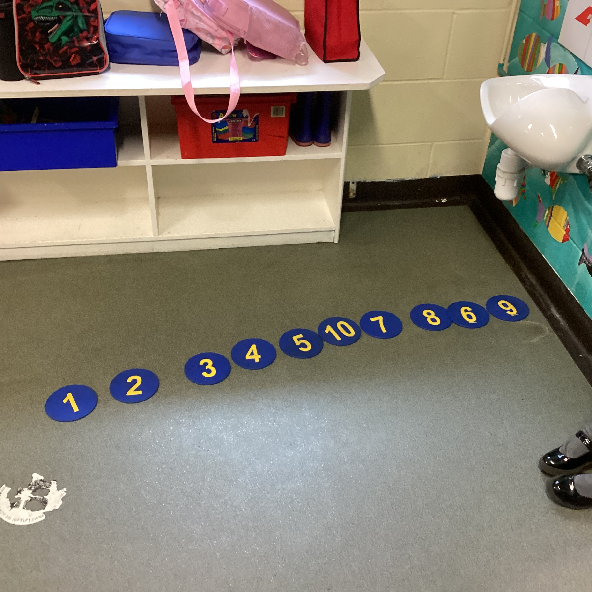
Mathematical Development
Number
Numerical patterns
Notes:
Maths is also a daily activity in Orange Tips. The children will be exploring lots of concepts linked to number and shape space a measure. Initially we will be focusing on number, in particular counting and number formation. As the year progresses the children will then move onto trickier concepts such as addition, subtraction, time and money etc. All maths activities are carefully planned so that they are fun and engaging and take place both inside and outside of the classroom. the children will be encouraged to communicate their mathematical thinking in a wide variety of ways including through manipulation of resources, mark-making and talk.

Slide 15
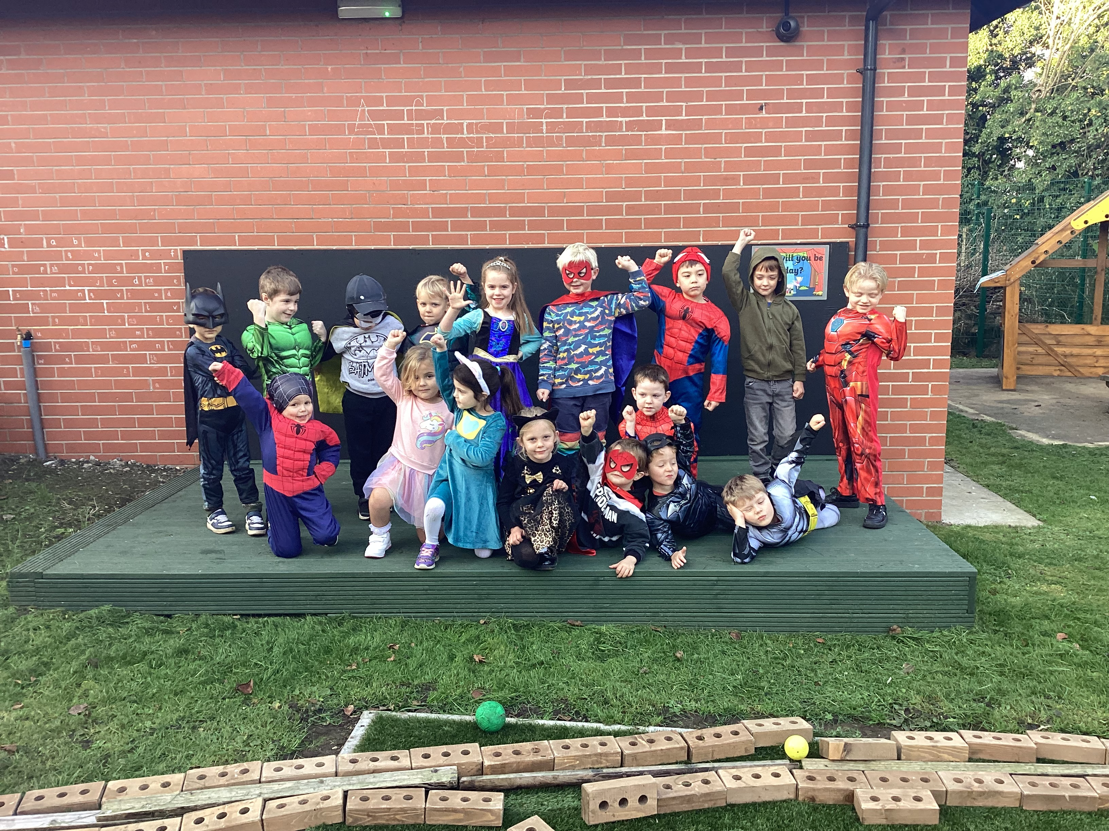
Expressive Arts and Design
Creating with materials
Being imaginative and expressive
Notes:
Expressive arts and design is used to develop a child's imagination, creativity and their ability to use media and materials. Children do this in range of ways including singing songs and making music, dancing, playing with colours, textures and design. The children have daily access to a craft area where they will be encouraged to make and create in a range of different ways.

Slide 16
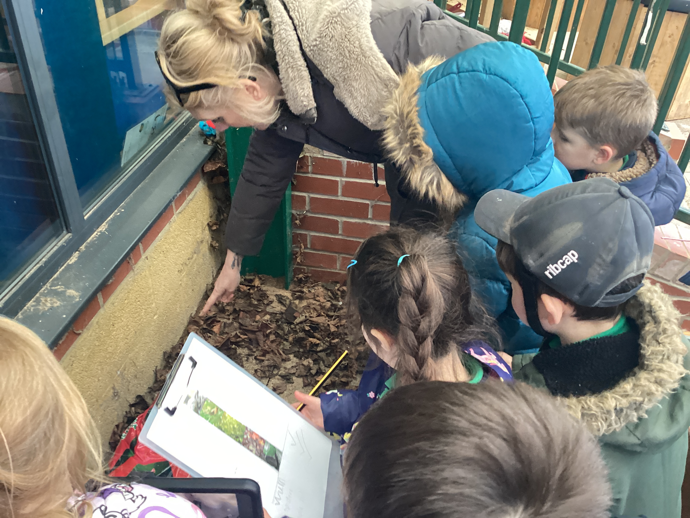
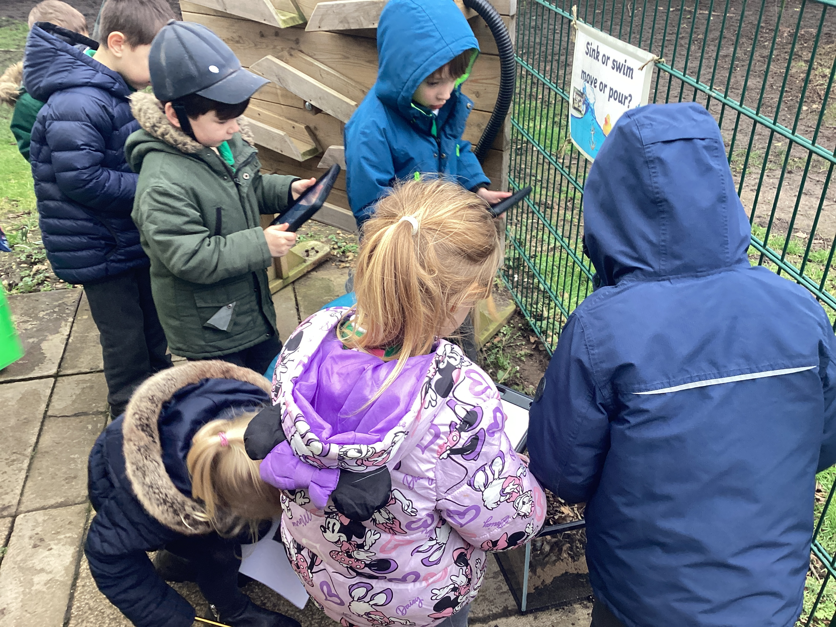
Understanding the World
Past and Present
People, culture and communities
The natural world
Notes:
This involves guiding children to make sense of their physical world and their community through opportunities to explore, observe and find out about people, places, technology, and the environment. UW enables children to explore and investigate their learning environments. enables children to communicate, interact and talk about what they want to do. enables children to feel they are valued. relates learning to themselves, their own lives and the real world.
At st gilberts the children have a weekly forest school session every other term. The principles of forest school takes place in a woodland or natural environment to support the development of a relationship between the learner and the natural world. Playing and learning outside improves children’s physical and emotional wellbeing and the forest school experience has been shown to be hugely beneficial for children with a range of emotional and developmental needs. Rather than using classroom resources and equipment, children can use natural materials found in the woodland and enjoy activities such as collecting sticks and leaves, tying knots, making dens, handling tools, using twigs to write in the mud, climbing trees, jumping across stones and building fires.

Slide 17



A Typical School Day
Time | Activity
8:45 | Arrive on the playground; greeted by Ms Markley/Miss Craigie
8:50 | Registration and morning activities
9:10 | phonics
9:50 | Maths
10:15 | Play time on playground
10:30 | Story time- class reader, milk and snack
10:40 | Reading, fine motor skills development-eg dough disco phonics games
11:15 | Outside learning EYFS garden
12:00 | Lunchtime-All EYFS/KS1 children are entitled to a free school meal
1:00 | Topic based adult directed and child-initiated activities
3:05 | Assembly
3:30 | Home time (parents are to collect children from the gate)
Notes:
This is an example of a typical school day at St gilbert’s school.

Slide 18


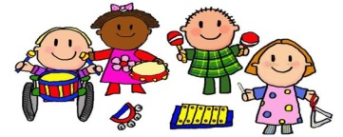
Tapestry Learning Journeys
Throughout the year we make lots of observations of the children’s learning.
The observations are used to create an online
learning journey on a secure server.
Tapestry online learning journeys allow you to view your child’s observations and photographs and to add your own observations or comments about the fantastic things that the children do at home.
Notes:
Lots of parents will already be aware of Tapestry when your child attended nursery. In Reception we continue to use Tapestry as it is a great tool to capture your child’s development through observations but also it is really useful for communicating between school and home.
Throughout the year we make lots of observations of the children’s learning.
The observations are used to create an online
learning journey on a secure server.
Tapestry online learning journeys allow you to view your child’s observations and photographs and to add your own observations or comments about the fantastic things that the children do at home.

Slide 19



Communication Between
Home and School
Reading book and reading record.
Please read with your child regularly and write in this book.
Tapestry.
Mrs Markley, Miss Craigie are available before and after school.
Parents evenings (2 during the year; October and February).
A formal written end of year report: July.
Informal chats during the year as required and encouraged… please!

Slide 20
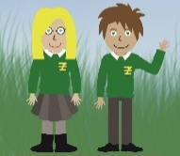
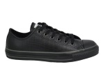



Uniform and Equipment
All MUST be labelled please!!!
School Uniform: Grey skirt/trousers, white or green polo shirt, green cardigan/sweatshirt, green checked summer dresses, white/grey or black socks or tights.
PE kit: green shorts, (Black joggers or leggings in winter) white t-shirt and plimsolls. (no laces please) Children attend school wearing their PE kits,
Forest School Kit: waterproofs, wellies, warm clothes (leggings, joggers. Jumpers, socks)
Coat, sun hat, sun-cream, water bottle: waterproof jacket.
Book bag with book and reading diary (needs to be in school daily.
Spare clothing as required
(if any is borrowed please return it promptly and of course clean).
Notes:
Uniform
We understand there may be a problem with getting uniform in a timely fashion in preparation for the start of term. We do have some items of nearly new stock in school if you wish to look at this, but we cannot guarantee we will have the right sizes for you. However, please feel rest assured we will be very understanding if you have not been able to get a uniform delivery in time for the start of term.

Slide 21
Transition into School
3/10/17th July
EYFS transition stay and play sessions. 1:30-2:30
21st July
Move up morning 9:30-11:30

Slide 22



Other Matters…
Collection of Children
Please let us know if someone different is collecting your child. Sometimes things change but we will not be able to release a child to an unknown adult without your consent to do so. Ideally this will be given in writing or in person at the office. If this is done over the phone we will ask for an pre-arrange password to confirm it is with your consent.
Bus
Children on the bus will be issued with a letter which parents will need to sign and agree the days their children are on the bus, changes to this must also be provided in writing.
Contact details
It is vital you update the school with any new contact details as a matter of urgency, we have your most ‘precious belongings’ in our care and we may need to contact you to simply ask a question or seek you thoughts on a matter or on the rare occasion for something more serious.

Slide 23


Other Matters…
When a child can miss school
Children of school age must attend regularly and on time during term time.
Your child can only miss school if:
they are too ill
the school has authorised the absence
You must get permission from the headteacher if you are planning to take your child out of school during term time.
Your child may be allowed to miss school for
doctor, hospital or dental appointments
a death in the family or funeral
religious observation
Headteachers can only permit leave for a holiday in term time where there are exceptional circumstances.
If you do not get permission and you take your child out of school, you may get a fine

Slide 24




Other Matters…
Medical
Any sickness, diarrhoea, must be followed by at least 48 hours absence.
Head lice are common! Please check regularly and treat as recommended.
Any prescribed of medication (by the GP, with the child's name, DOB, dosage, expiry date and length of the course) can only be administered by if it is required 4 times a day, and with prior arrangement (there is paperwork to fill in!) at the school office.
If your child has an accident at school, you will be notified via email.
A ‘more significant’ incident will be reported to you via the telephone .
Let us know of any allergies including plasters!

Slide 25


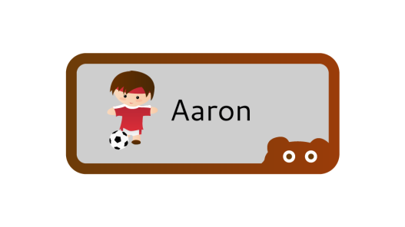


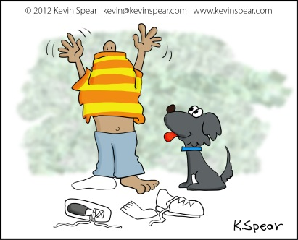
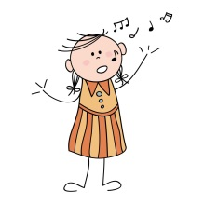
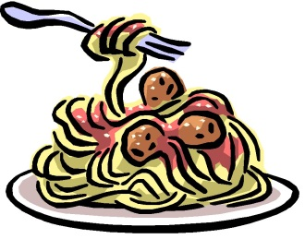
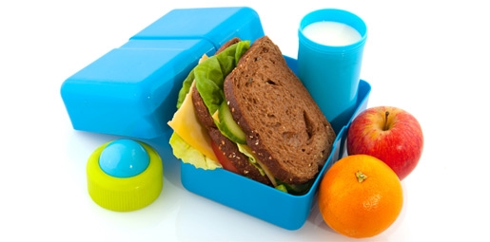
So what can you do?
Recognise name.
Self care (toileting, hand washing).
Dressing and undressing independently.
Lunchtime independence (opening lunch packets, knife and fork).
Informal learning – number songs, words in the environment, sharing stories.

Slide 26
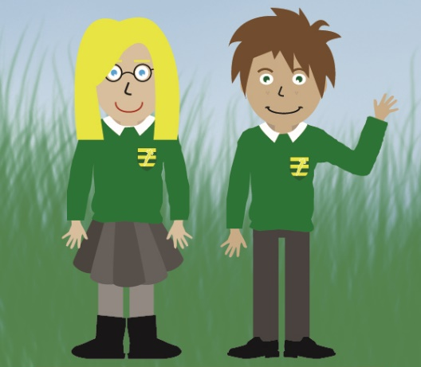
Thank You
We look forward to working with you during your child’s very exciting first year at school. This partnership will indeed grow throughout their time here at St. Gilbert’s.
Together we will ensure they will be very happy years with lots of cherished memories.
If you have any further questions, please feel free
to ask us at any time.

